Slide 1
Natural Language Processing
Lecture-1 : Introduction to Natural Language Processing

Slide 2
Course Policy
Assignments 10 %
Quizzes 10 %
Mid exam 20 %
Course Project 20 % **
End Exam 40%
Attendance 85%
** Research Project (Development/Implementation, Article Writing, Presentation)

Slide 3
Course Contents
Introduction to Natural Language Processing
Definition of Minimum Edit Distance
Weighted Minimum Edit Distance
Basic Text Processing and Text Normalization
Language Modeling
Text Classification and Naive Bayes
Sentiment and Binary Naive Bayes
Logistic Regression
Simple Neural Networks and Neural Language Models
Training Neural Nets: Overview
Introduction to Chatbots and Dialogue Systems
Rule-based Chatbots: ELIZA and PARRY
Deep Architectures for NLP
Long Term Dependencies in NLP Applications

Slide 4
Books and Resources
“Speech and Language Processing”, by Dan Jurafsky and James H. Martin.
“Natural Language Processing in Action: Understanding, analyzing, and generating text with Python”, by Cole Howard, Hannes Max Hapke, and Hobson Lane.
“Natural Language Processing with Python”, by Edward Loper, Ewan Klein, and Steven Bird.
Foundations of Statistical Natural Language Processing. Chris Manning and Hinrich Schütze.
World Wide Web (WWW)

Slide 5
What is this Course about?
Natural language processing (NLP) or Computational Linguistics is one of the most important technologies of the information age.
In recent years, Deep Learning (or Neural Network) approaches have obtained very high performance across many different NLP tasks, using single end-to-end neural models that do not require traditional, task-specific feature engineering.
Applications of NLP are everywhere because people communicate almost everything in language:
web search
Advertising
Emails and customer service
language translation and virtual agents
medical reports.

Slide 6
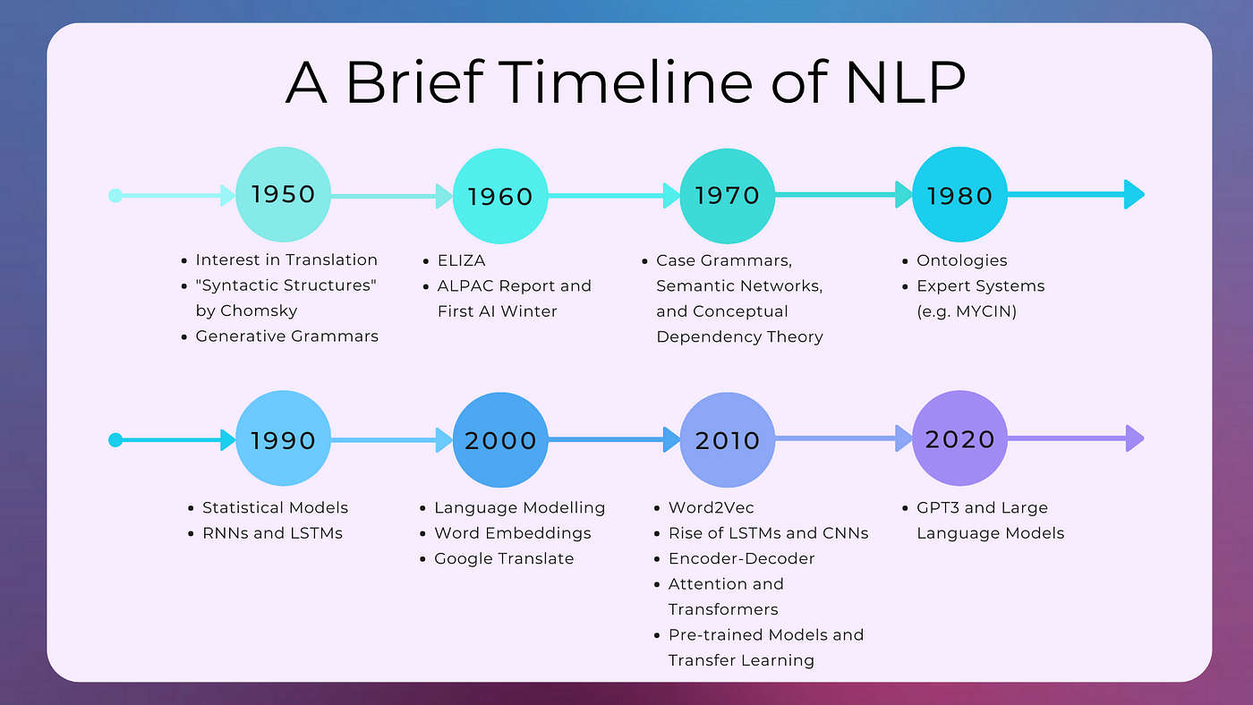

Slide 7
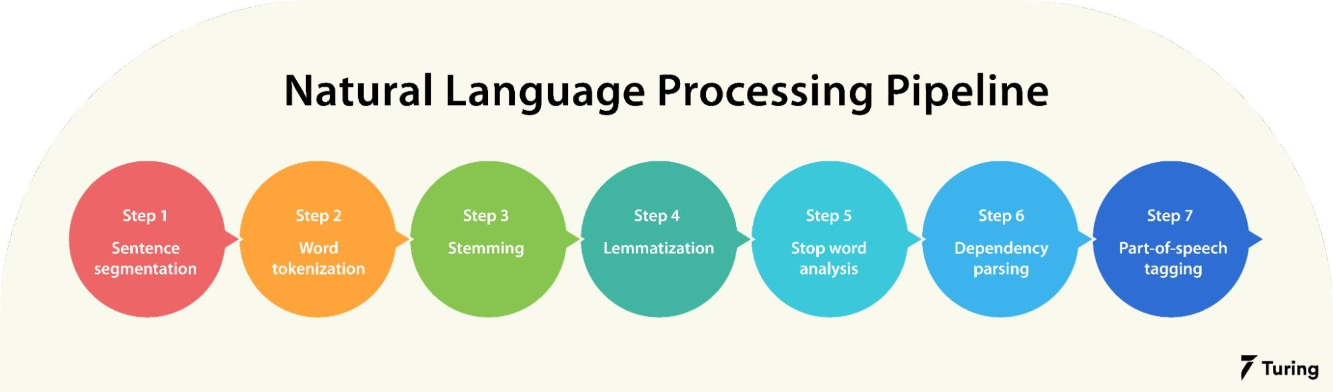
NLP Pipeline (1)
Notes:
Stemming normalizes words into their base or root form. For example, intelligently, intelligence, and intelligent. These words originate from a single root word ‘intelligen’. Lemmatization removes inflectional endings and returns the canonical form of a word or lemma. It is similar to stemming except that the lemma is an actual word. For example, ‘playing’ and ‘plays’ are forms of the word ‘play’. Hence, play is the lemma of these words. Unlike a stem (recall ‘intelligen’), ‘play’ is a proper word. Dependency parsing is a linguistic analysis technique used in natural language processing to uncover grammatical relationships between words in a sentence. It involves parsing a sentence's structure to create a tree-like representation that shows how words depend on one another.

Slide 8
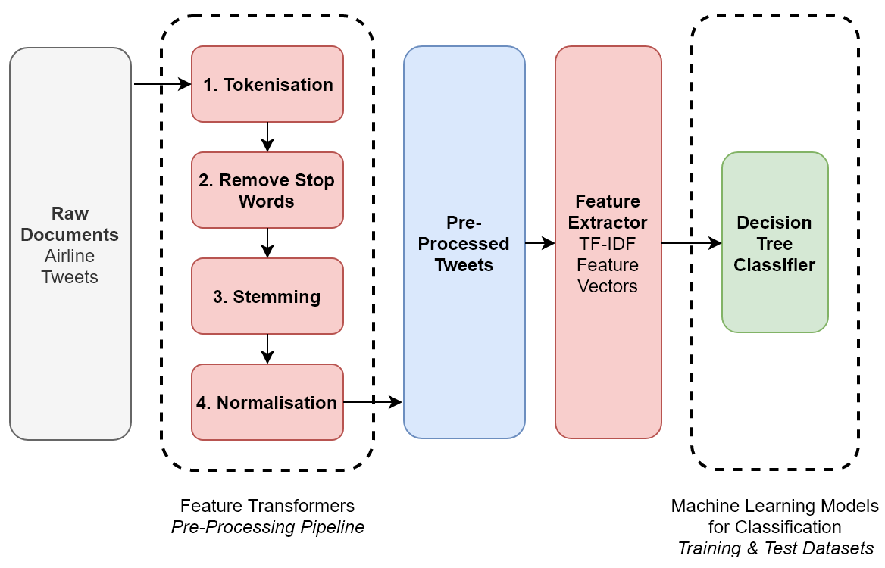
NLP Pipeline (2)
Notes:
TF-IDF (Term Frequency – Inverse Document Frequency):
TF-IDF tries to quantify the importance of a given word relative to the other word in the corpus. it is mainly used in Information retrieval.
Term Frequency (TF): TF measures how often a word occurs in the given document.

Slide 9
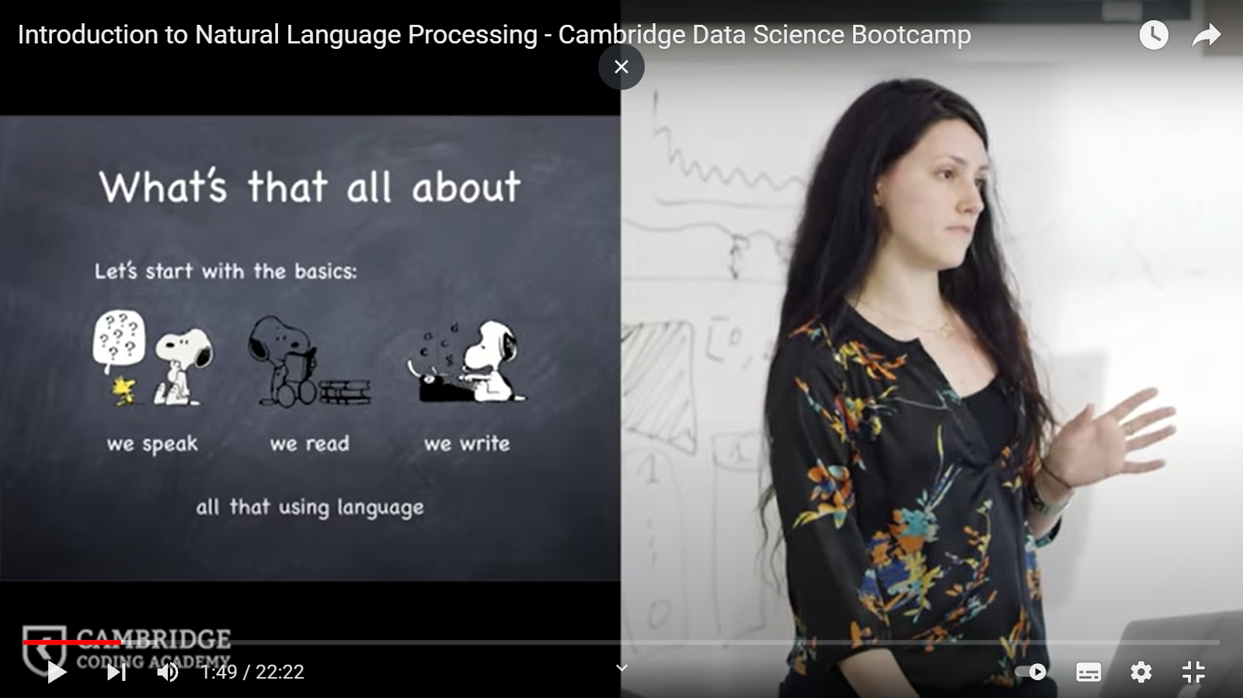
Natural Language Processing
English Language
Chinese Language
Python Language

Slide 10
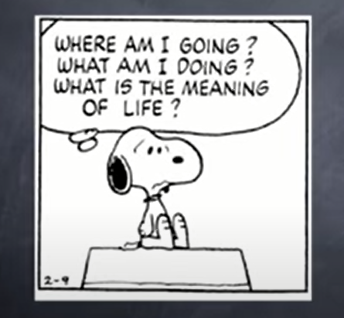
But that’s not all….
We think of the world around us
We dream
We make decisions and Plans
All in Natural Language, i.e. in Words

Slide 11
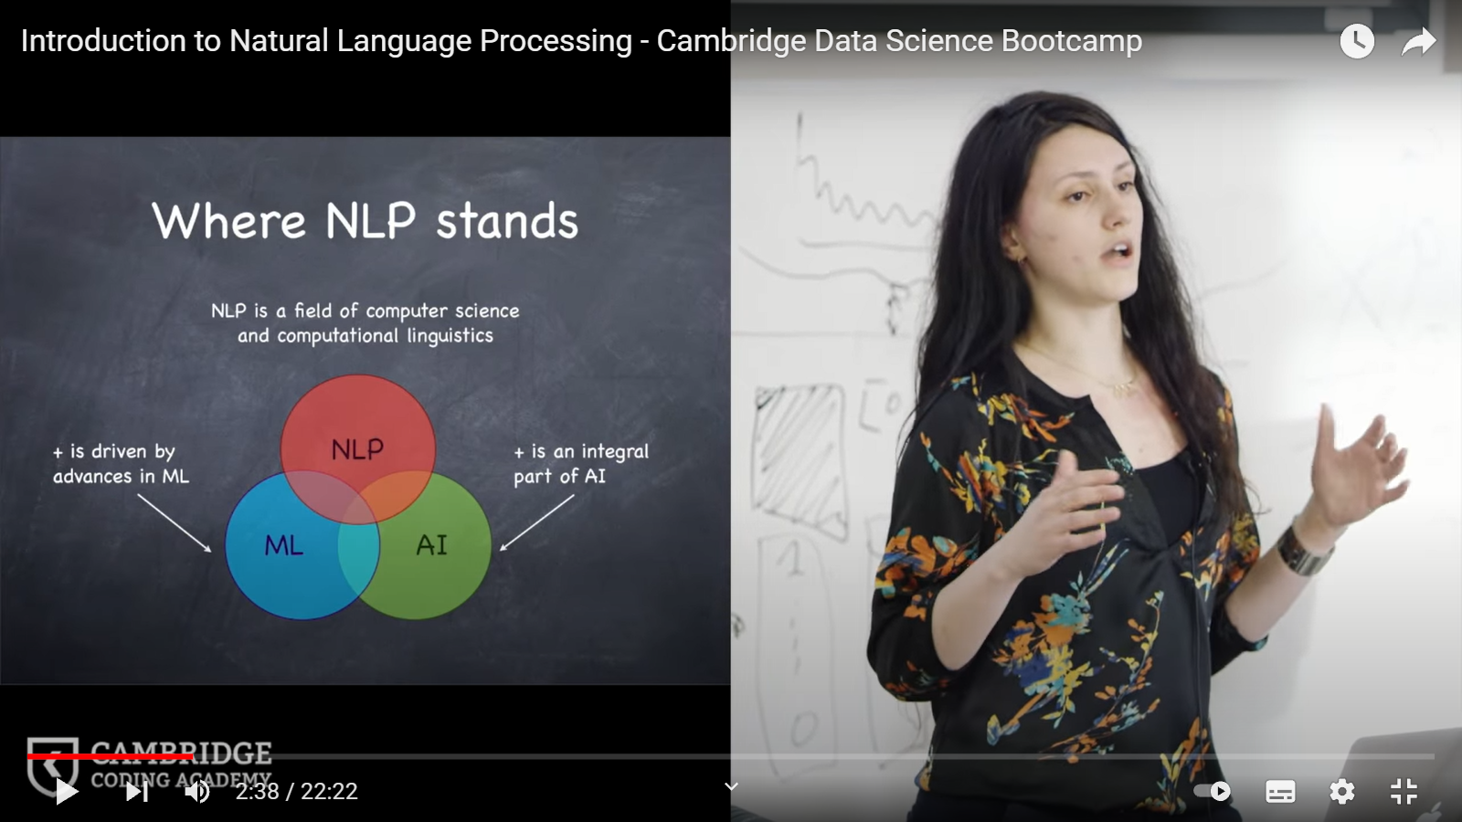
Where NLP Stands
NLP is a Field of Computer Science and Computational Linguistics

Slide 12
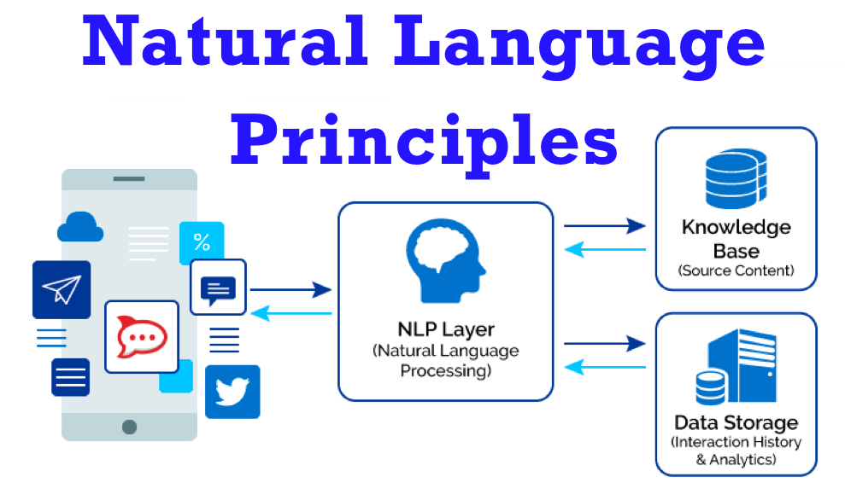
Natural Language Principles

Slide 13
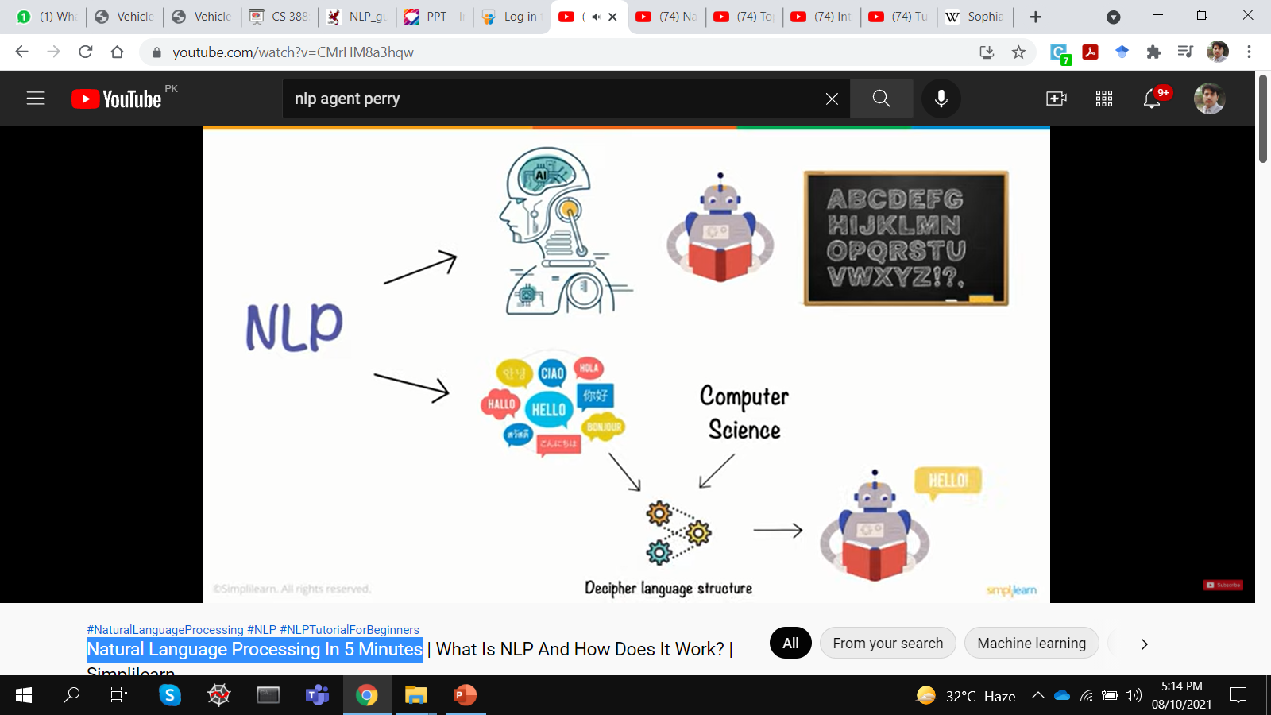
Working of NLP

Slide 14
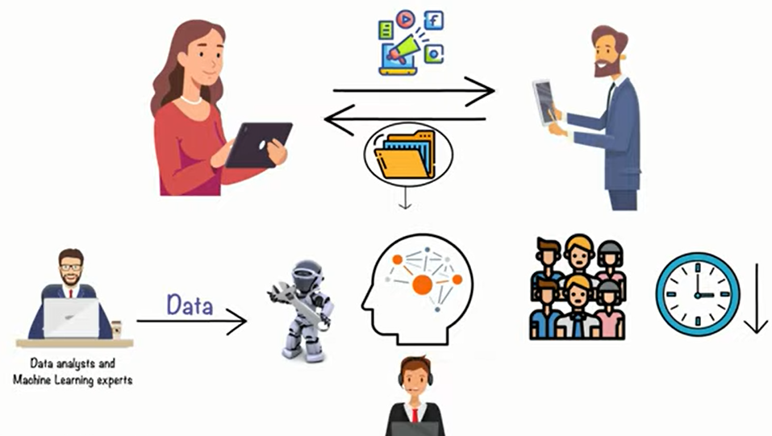
Working of NLP

Slide 15
Linguistics Terminologies
Phonetics and Phonology | The study of language sounds
Ecology | The study of language conventions for punctuation, text mark-up and encoding
Morphology | The study of meaningful components of words
Syntax | The study of structural relationships among words
Lexical semantics | The study of word meaning
Compositional semantics | The study of the meaning of sentences
Pragmatics | The study of the use of language to accomplish goals
Discourse conventions | The study of conventions of dialogue

Slide 16
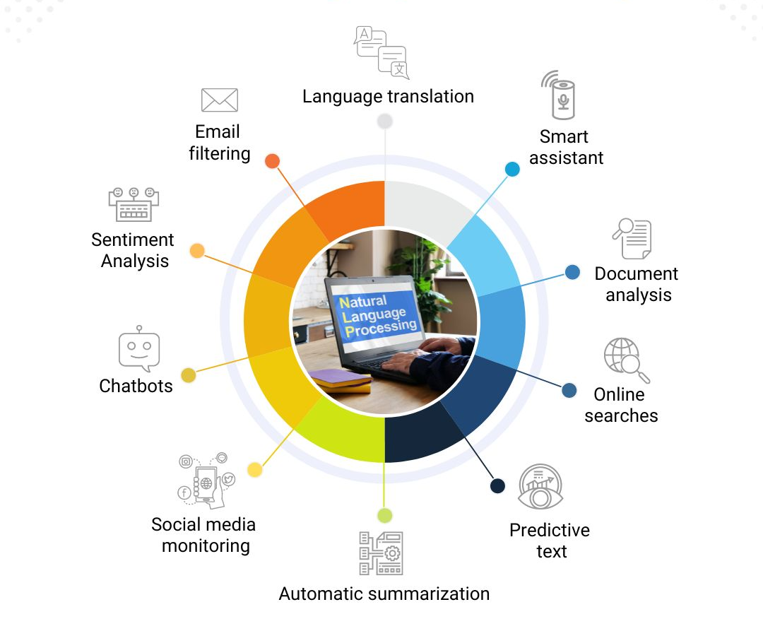
NLP Applications

Slide 17
NLP Applications
Finding appropriate documents on certain topics from a database of texts (for example, finding relevant books in a library)
Extracting information from messages or articles on certain topics (for example, building a database of all stock transactions described in the news on a given day)
Translating documents from one language to another (for example, producing automobile repair manuals in many different languages)
Summarizing texts for certain purposes (for example, producing a 3-page summary of a 1000-page government report)

Slide 18
NLP Applications
Question-Answering Systems, where natural language is used to query a database (for example, a query system to a personnel database)
Automated Customer Service over the telephone (for example, to perform banking transactions or order items from a catalogue)
Tutoring Systems, where the machine interacts with a student (for example, an automated mathematics tutoring system)
Spoken Language Control of a machine (for example, voice control of a VCR or computer)

Slide 19
Production-Level Applications
A computer program in Canada accepts daily weather data and automatically generates weather reports in English and French
Over 1,000,000 translation requests daily are processed by the Babel Fish system available through Altavista
A visitor to Cambridge, can ask a computer about places to eat using only spoken language. The system returns relevant information from a database of facts about the restaurant scene.

Slide 20
Prototype-Level Applications
Computers grade student essays in a manner indistinguishable from human graders
An automated reading tutor intervenes, through speech, when the reader makes a mistake or asks for help
A computer watches a video clip of a soccer game and produces a report about what it has seen
A computer predicts upcoming words and expands abbreviations to help people with disabilities to communicate

Slide 21
Components of NLP
There are two components of NLP as given
Natural Language Understanding (NLU)
Mapping the given input in natural language into useful representations.
Analyzing different aspects of the language.
Natural Language Generation (NLG)
It is the process of producing meaningful phrases and sentences in the form of natural language from some internal representation.
It involves:
Text planning − It includes retrieving the relevant content from knowledge base.
Sentence planning − It includes choosing required words, forming meaningful phrases, setting tone of the sentence.
Text Realization − It is mapping sentence plan into sentence structure.
The NLU is harder than NLG.

Slide 22
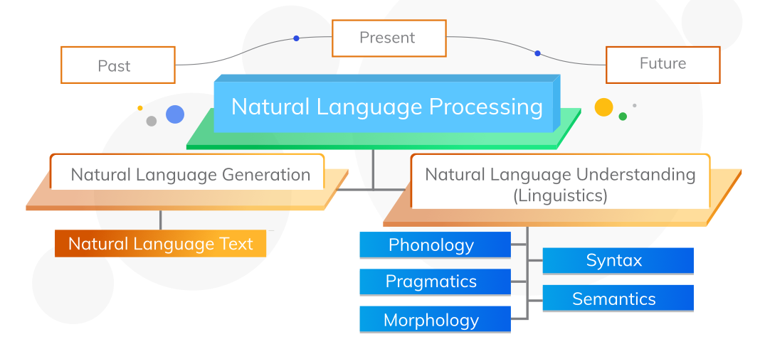
Evolution of NLP

Slide 23
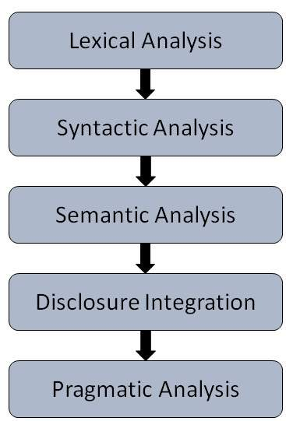
Steps or Stages in NLP
Lexical Analysis − It involves identifying and analyzing the structure of words. Lexical analysis is dividing the whole chunk of text into paragraphs, sentences, and words.
Syntactic Analysis (Parsing) − It involves analysis of words in the sentence for grammar and arranging words in a manner that shows the relationship among the words. The sentence such as “The school goes to boy” is rejected by English syntactic analyzer.
Semantic Analysis − It draws the exact meaning or the dictionary meaning from the text. The semantic analyzer disregards sentence such as “hot ice-cream”.

Slide 24
Steps or Stages in NLP
Discourse Integration − The meaning of any sentence depends upon the meaning of the sentence just before it. In addition, it also brings about the meaning of immediately succeeding sentence.
Pragmatic Analysis − During this, what was said is re-interpreted on what it actually meant. It involves deriving those aspects of language which require real world knowledge.

Slide 25
Top Libraries of NLP in Python
Natural Language Toolkit (NLTK)
Gensim
CoreNLP
spaCy
TextBlob
Pattern
PyNLPl

Slide 26
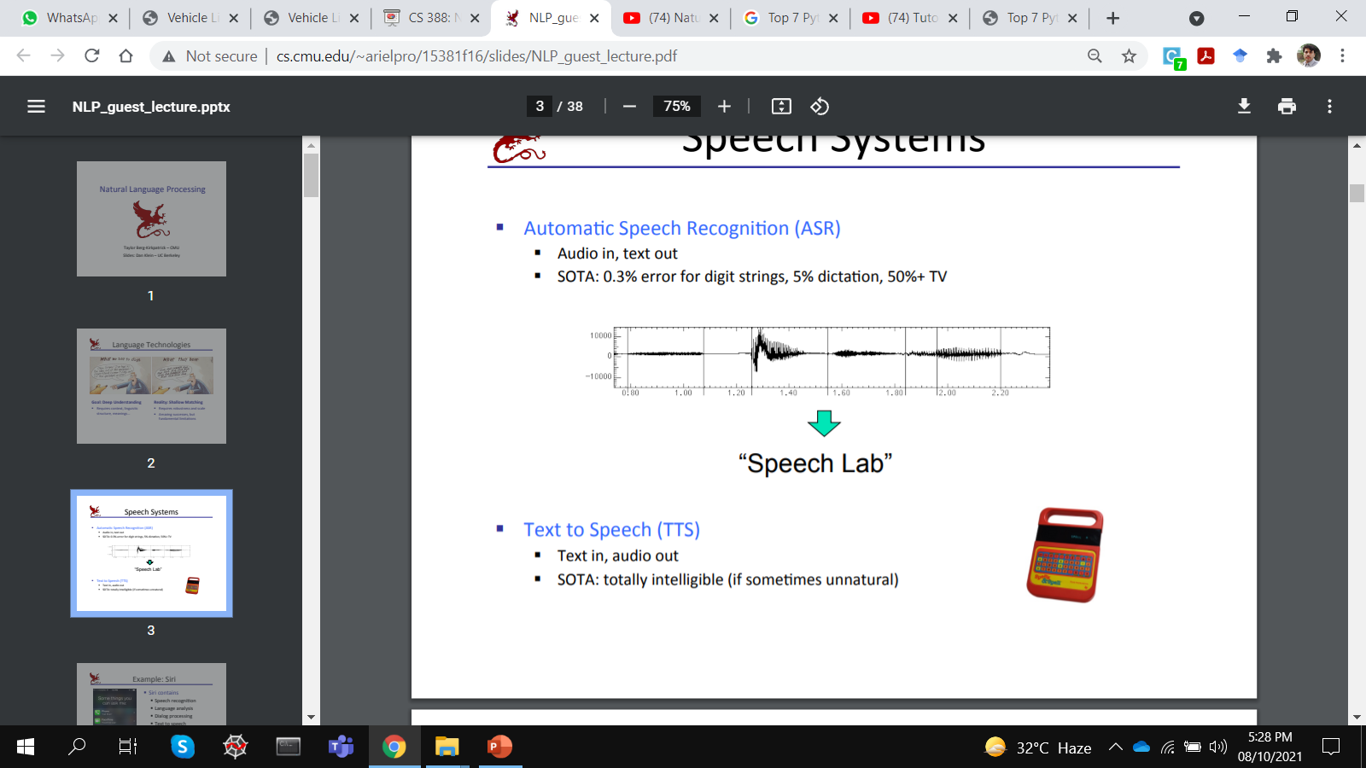
Speech Systems

Slide 27
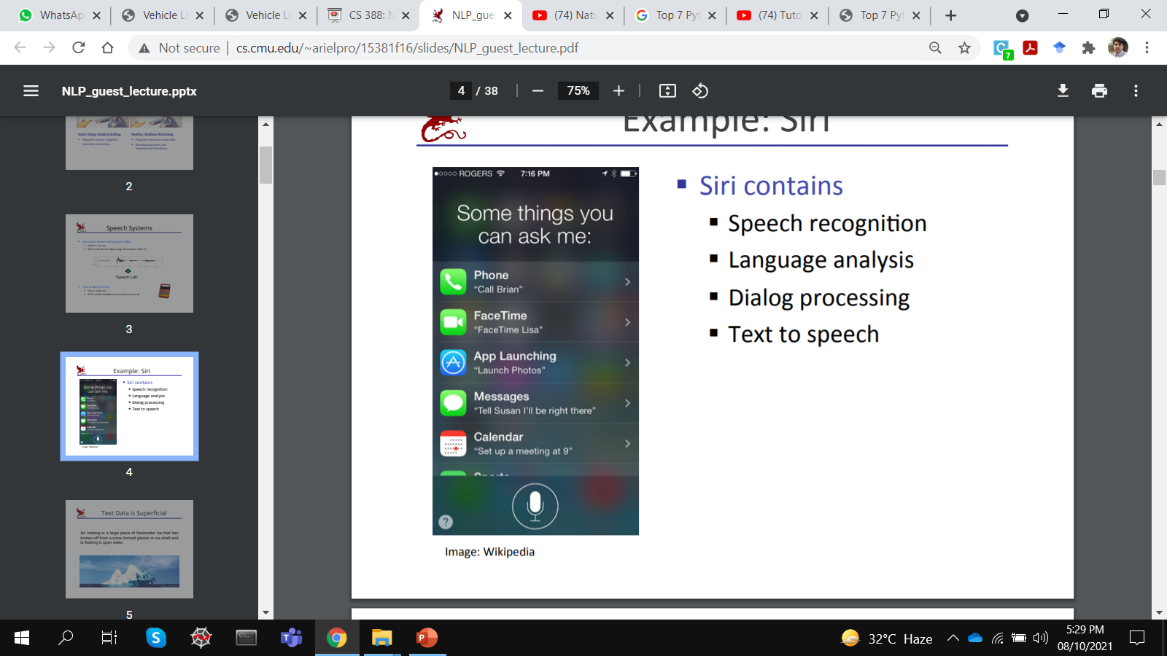
Speech Systems (siri)

Slide 28

Before Siri and Alexa, there was ELIZA

Slide 29
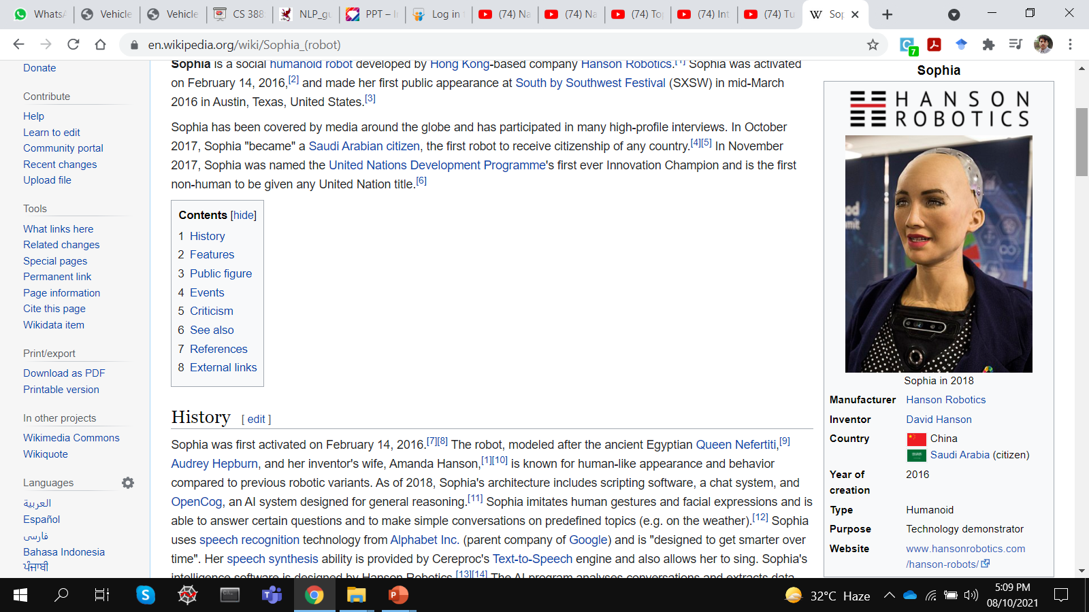

Sophia (robot)

Slide 30

The Voice Assistant Battle

Slide 31
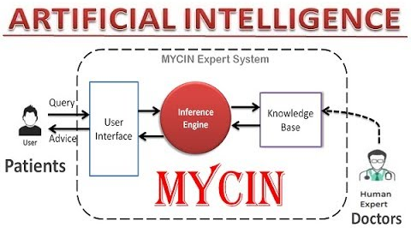
Expert Systems

